Slide 1
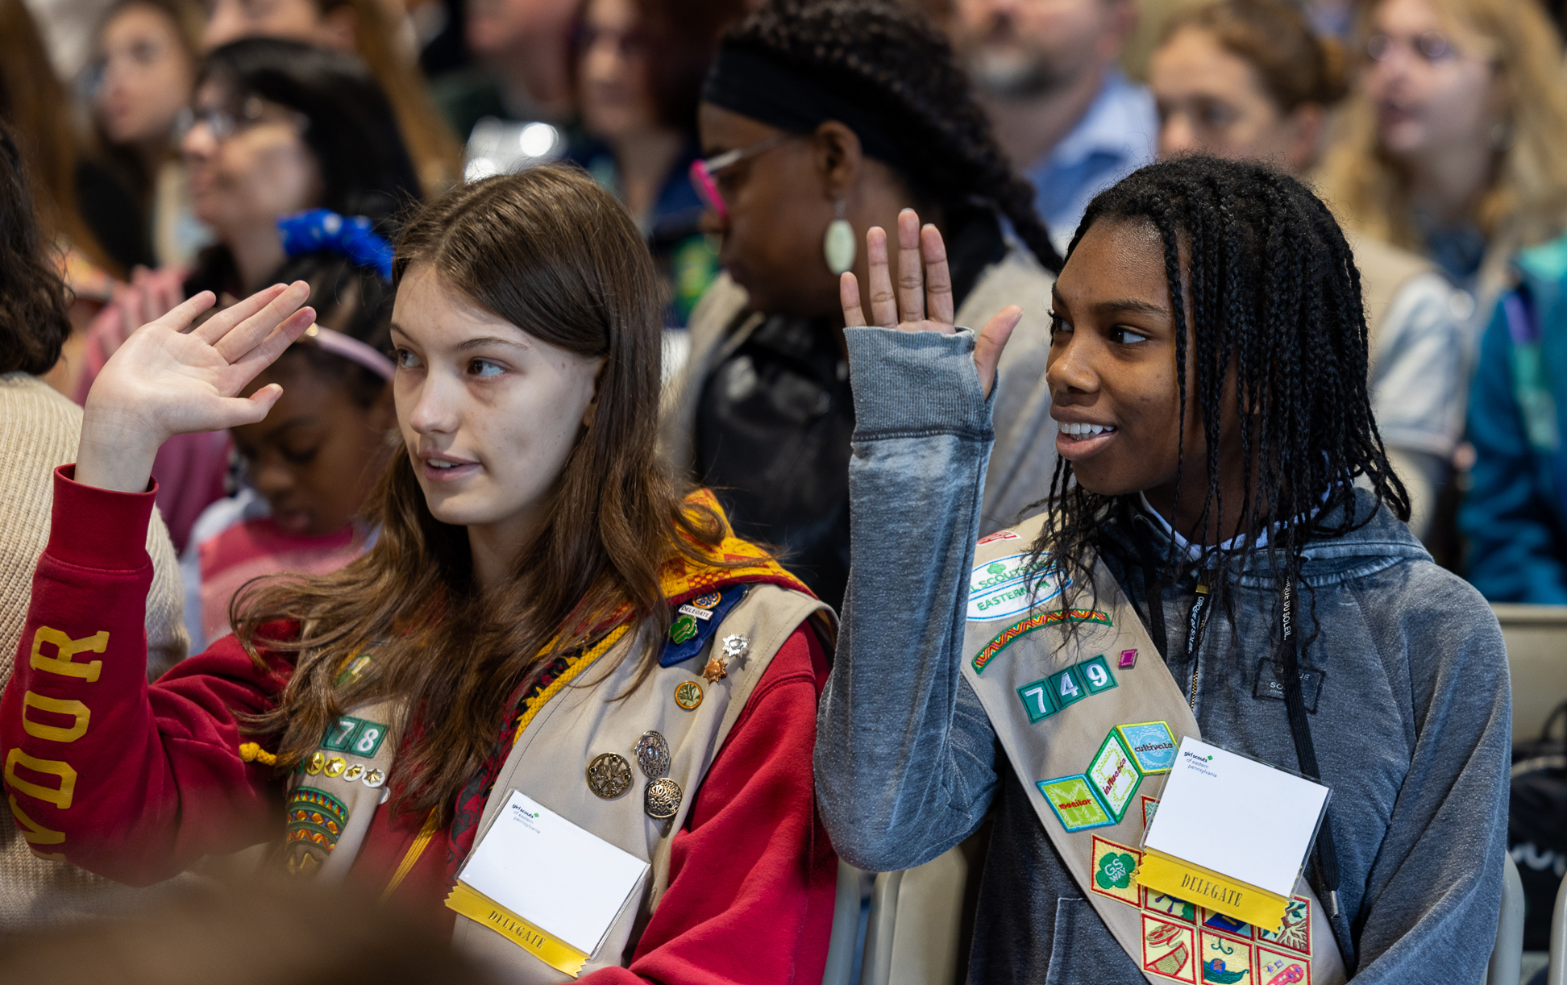
What does a Service Unit Delegate actually do?
Attend Delegate training (one session)
Participate in three Delegate Council meetings (Fall, Winter, & Spring)
  After each meeting, you should share the information, news, and updates you heard from the Board Chair & CEO & speakers with your Service Unit. Please gather any additional input from your SU to share at the next Delegate Council meeting or by emailing governance@gsep.org
  Most meetings also include a Strategy Café discussion on a governance topic impacting GS & GSEP. You will get to interact with Board members directly and other SU Delegates and Girl Delegates.
Attend & participate in the Annual Meeting (first Saturday morning in May)
  This is when Delegates vote on new Board members, etc. as well as any changes to the Bylaws.
  You will also hear the Treasurer’s Report (on Council finances), the CEO’s State of the Council, and a governance update from the Board Chair.
Service Unit Delegates
@ the 2024 Annual Meeting
Please note:
Service Unit Delegates should be elected between April – August… because their one-year term ends at the conclusion of the Annual Meeting in May (regardless if they were elected in April or September or January….). Our Governance Year runs May-May.
Notes:
ANGIE:
Thanks, Deb.
Delegates elected by Service Units represent the entire Council. This concept is important to understand…. Because what is easy or good or obvious in your Service Unit may not work or is challenging or simply hasn’t been considered in another Service Unit. So, as we discuss issues, we have to think about the ENTIRETY of our Council.
SU Delegates are also expected to attend Delegate education sessions like this one as well as the Fall, Winter, and Spring Delegate Meetings and the Annual Meeting.
They are also expected to talk with volunteers, troop leaders, girls and parents in their service unit and share their questions and thoughts at Delegate Meetings and to communicate governance news at Service Unit meetings.
These are the responsibilities of all Delegates
How can you communicate with others?
Attendees:
In my Service Unit I can ask for time to share the work of the Delegate Council. And I can ask the SU to share their thoughts on the conversation. Then I can bring my SU input back to the Delegate Council
When I was a Girl Delegate, I got to participate in Girl only Strategy Café conversation at Delegate Council Meetings
I can share and have the same conversations in my GS troop meetings

